Slide 1
Textual Adversarial Attack
arXiv_20200103_Towards a Robust Deep Neural Network in Texts: A Survey
arXiv_20191009_Adversarial Attacks and Defenses in Images, Graphs and Text: A Review
2020.11.21 • ChongQing
Reported by Chenghong Li

Slide 2
1. Introduction
2. Classification
3. Evaluation and Metrics
4. Adversarial Attacks
5. Challenges

Slide 3
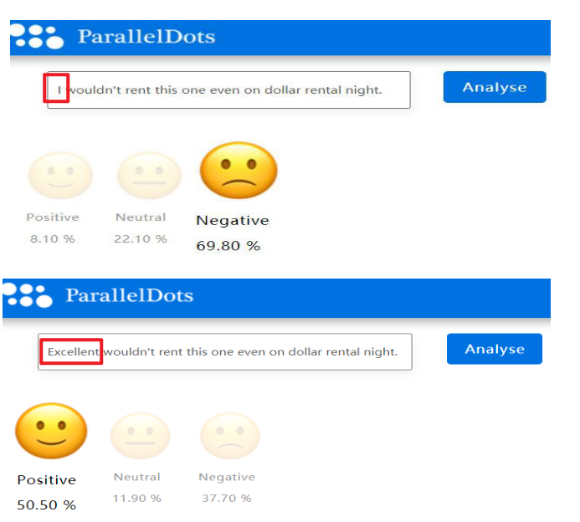
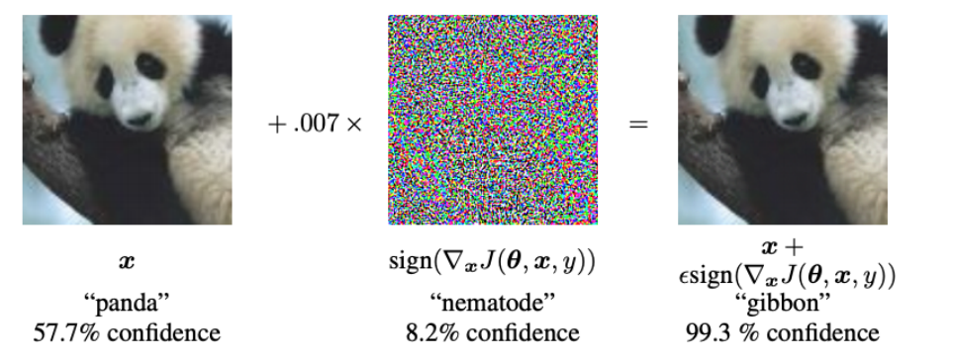
Introduction
By adding an unnoticeable perturbation, “panda” is classified as “gibbon”.
The prediction results change from negative to positive when the word 'I' in the original sample is replaced by 'Excellent'

Slide 4
Introduction
ATTACK: Adversarial examples are inputs to machine learning models that an attacker intentionally designed to cause the model to make mistakes.
DEFENSE: Attempt to check whether a sample is benign or adversarial before feeding it to the deep learning models.
Studying adversarial examples and their countermeasures is also beneficial for us to understand the nature of DNNs and consequently improve them.
Notes:
图像和文本的不同之处
文本对抗概念：

Slide 5
Classification : Attack
1. According to the victim model visibility:
White-Box Attack
Adversaries have full access to target models and they can obtain excellent adversarial examples by the use of models' architectures, parameters, and weights.
Black-Box Attack
The inner configuration of DNN models is unavailable to adversaries. Adversaries can only feed the input data and query the outputs of the models.

Slide 6
Classification : Attack
2. According to the purpose of adversaries:
Targeted Attack
An attack that causes the victim model to give the specified false judgement.
Non-targeted Attack
It is only necessary to make the model judgment wrong against the sample.

Slide 7
Classification : Attack
3. Adversarial attacks in texts:
Character-level Attack
The common methods include adding, deleting, replacing, exchanging order and so on.
e.g.
The weather is good today. → The waether is good today.

Slide 8
Classification : Attack
3. Adversarial attacks in texts:
Word-level Attack
The word-level attack modifies words by synonyms, typos, genre specific keywords, etc.
e.g.
The weather is good today. → The weather is god today.

Slide 9
Classification : Attack
3. Adversarial attacks in texts:
Sentence-level Attack
Common sentence level attack methods include paraphrasing, add crafted sentences into the inputs, etc.
e.g.
The weather is good today. → The weather is good today. I have a pen.

Slide 10
Classification : Defense
4. Defense:
Detection
Spelling check.
Model Enhancement
Enhance the robustness of DNNs during training, including counter training, changing the loss function of the model, testing and verification methods.

Slide 11
Evaluation and Metrics
1. Evaluation on Effectiveness:
Accuracy Rate
It refers to the ratio of correct discrimination on the inputs.
The lower the accuracy rate is, the more effective the adversarial examples are.
Error Rate
It is the ratio of incorrect discrimination on the inputs, which is opposite to the accuracy rate.
The higher the error rate is, the more effective the adversarial examples are.

Slide 12
Evaluation and Metrics
2. Metrics in Texts:
Euclidean Distance
word vectors:
Cosine Distance
Jaccard Similarity Coefficient
Word Movers Distance
Edit Distance

Slide 13
Adversarial Attacks
1. Attack on Classification in Texts
Attack word embedding
Add perturbation on the word embedding so as to fool a LSTM classifier. However, this attack only considers perturbing the word embedding, instead of original input sentence.
2016_Adversarial training methods for semi-supervised text classification

Slide 14
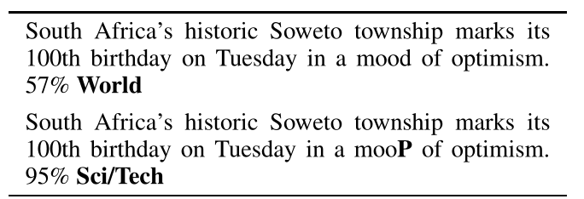
Adversarial Attacks
1. Attack on Classification in Texts
Attack words and letters
Replace a letter in a sentence in order to mislead a character-level text classifier.
The attack algorithm manages to achieve this by finding the most-influential letter replacement via gradient information.
These adversarial perturbations can be noticed by human readers, but they don’t change the content of the text as a whole, nor do they affect human judgments.
ACL_2018_HotFlip: White-Box Adversarial Examples for Text Classification

Slide 15
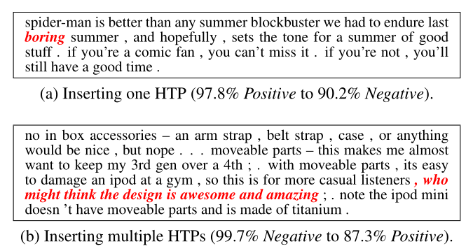
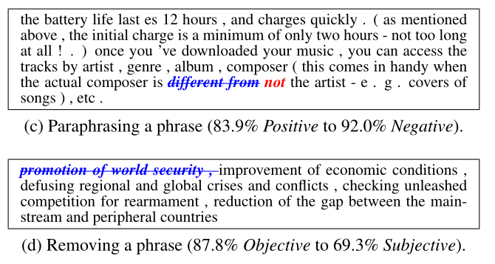
Adversarial Attacks
1. Attack on Classification in Texts
Attack words and letters
Adding, removing or modifying the words and phrases in the sentences
For each training sample, they find the most-influential letters, called “hot characters”.
Then, they label the words that have more than 3 “hot characters” as “hot words”.
IJCAI_2018_Deep Text Classification Can be Fooled

Slide 16
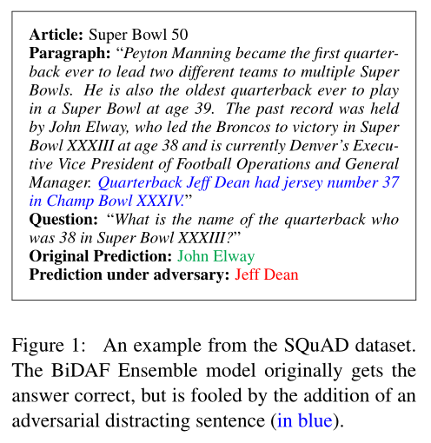
Adversarial Attacks
2. Attack on Reading Comprehension Systems
The authors successfully degrade the intelligence of the reading comprehension by inserting adversarial sentences.
The inserted sentence (blue) looks similar to the question, but it does not contradict the correct answer.
This inserted sentence is understandable for human readers but confuses the machine a lot.
EMNLP_2017_Adversarial Examples for Evaluating Reading Comprehension Systems

Slide 17
Adversarial Attacks
3. Attack on Neural Machine Translation
The work studies the stability of machine learning translation tools when their input sentences are perturbed from natural errors (typos, misspellings, etc.) and manually crafted distortions (letter replacement, letter reorder).
ICLR_2018_Synthetic and Natural Noise Both Break Neural Machine Translation
Seq2Sick tries to attack seq2seq models in neural machine translation and text summarization.
In their setting, two goals of attacking are set: to mislead the model to generate an output which has on overlapping with the ground truth, and to lead the model to produce an output with targeted keywords.
AAAI_2020_Seq2Sick: Evaluating the Robustness of Sequence-to-Sequence Models with Adversarial Examples

Slide 18
Challenges
Currently , the majority of studies on adversarial texts is about theoretical models and rarely related to practical applications.
There do not exist well-performed adversarial examples which can fool any DNNs

Slide 19
Evaluating and Enhancing the Robustness of Neural Network-based Dependency Parsing Models with Adversarial Examples
ACL_2020
Code:https://github.com/zjiehang/DPAttack
2020.11.21 • ChongQing
Reported by Chenghong Li

Slide 20
1. Introduction
2. Method
3. Experiments
4. Conclusion

Slide 21
Introduction
Previously studies along this line mainly focused on semantic tasks such as sentiment analysis, question answering and reading comprehension.
Adversarial examples also exist in dependency parsing.
Construct syntactic adversarial examples to fool a dependency parser without changing the original syntactic structure.

Slide 22
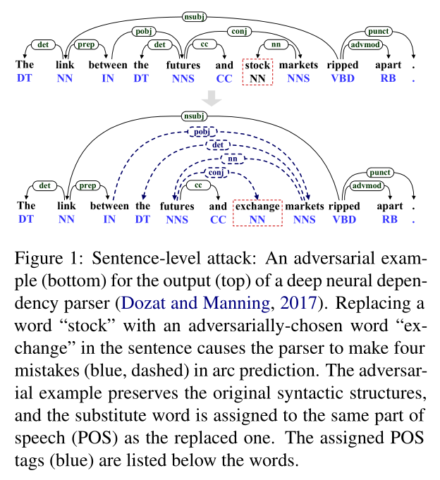
Introduction
Notes:
敌对的例子保留了原句法结构，并且替换词与被替换词的词性相同

Slide 23
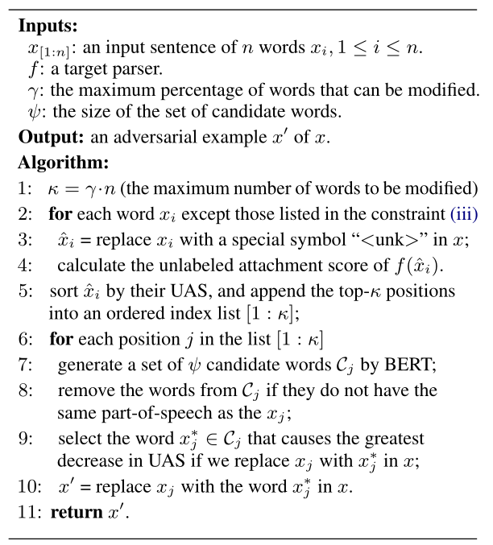
Method
black-box setting
Constraint (iii) :
Pronouns, articles, conjunctions, numerals, interjections, interrogative determiners, and punctuations are not allowed to be replaced.
e.g.
Step1:
The link beteen the futures and stock markets ripped apart.
The <unk> beteen the futures and stock markets ripped apart.
The link beteen the <unk> and stock markets ripped apart.
The link beteen the futures and <unk> markets ripped apart.
... ...
> sort by UAS socre, top-k positions
Notes:
无标记依存正确率(UAS):测试集中找到其正确支配词的词所占总词数的百分比。

Slide 24
Method
black-box setting
Constraint:
The substitute word $x_{i}^{′}$ should fit in well with the context, and can maintain both the semantic and syntactic coherence.
For any word $x_{i}$ in an original example, the word $x_{i}^{′}$ to replace $x_{i}$ must have the same part-of-speech (POS) as $x_{i}$ .
e.g.
Step2:
The link beteen the [w_11] and stock markets ripped apart.
The link beteen the [w_12] and stock markets ripped apart.
The link beteen the [w_13] and stock markets ripped apart.
... ...
The link beteen the futures and [w_21] markets ripped apart.
The link beteen the futures and [w_22] markets ripped apart.
The link beteen the futures and [w_23] markets ripped apart.
... ...

Slide 25
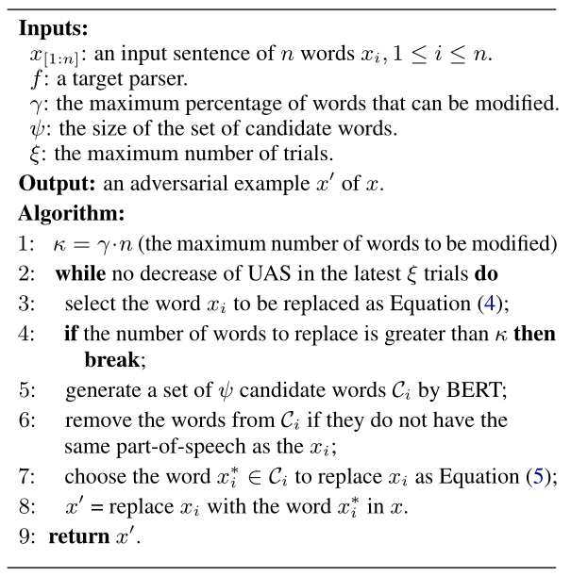
Method
white-box setting

Slide 26
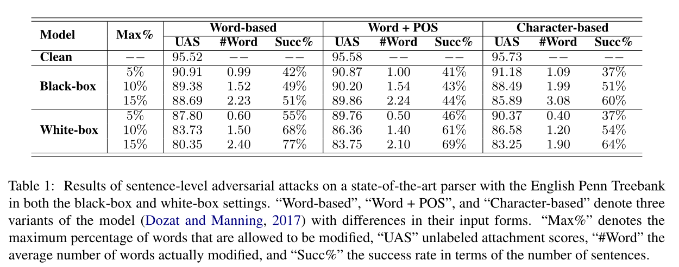
Experiments
ICLR_2017_Deep Biaffine Attention for Neural Dependency Parsing

Slide 27
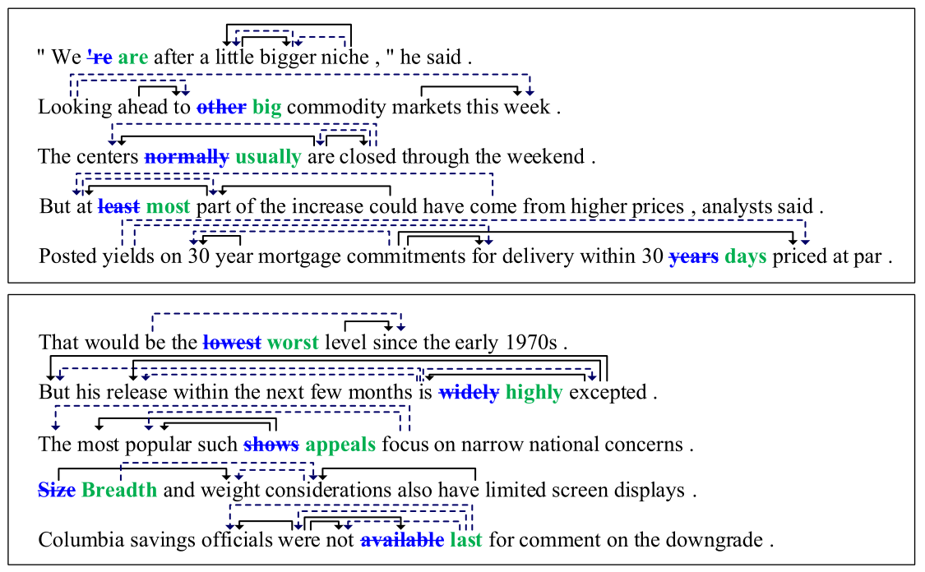
Experiments
Figure 5: Five adversarial examples each generated by our algorithms in the black-box (top) and white-box (bottom) settings. These adversarial examples were randomly extracted from the test set of the English Penn Treebank (PTB). The original words are highlighted in bold blue font while the substitute words are highlighted in bold green ones. The incorrect arcs (i.e. head-modifier pairs) predicted by the target parser are indicated by dash arrows while the ground truth arcs are indicated by solid arrows.

Slide 28
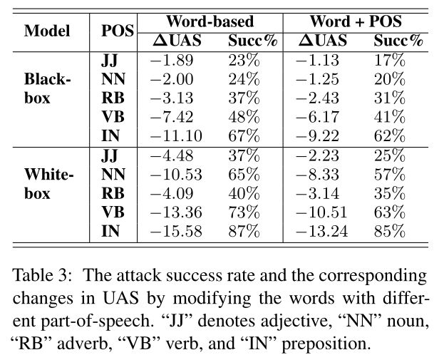
Experiments

Slide 29
Experiments

Slide 30
THANKS

